Slide 1
Retail Data Inspection
By : Athul Das P
08/10/25

Slide 2
Business Context
“The dataset used in this project represents a retail company’s transactional and operational data collected from multiple stores across different regions.
It contains detailed information about customers, orders, payments, products, stores, and customer reviews.
The main goal of this analysis was to perform a comprehensive data inspection to ensure the accuracy, consistency, and reliability of the data before it can be used for business insights or reporting.
Through this inspection, we identify issues such as duplicates, missing values, inconsistent formats, logical errors and data type mismatches, and propose suitable solutions to improve overall data quality and integrity.
Ultimately, the findings from this process help create a clean and reliable dataset that can support better sales analysis, customer understanding, and decision-making for the retail business.”

Slide 3
Data Dictionary (1/2)
Table Name | Primary key & foreign keys | Unique columns | Relationship | Description
Customers | Pk : Custid | customer_city, customer_state, Gender | One to many (Orders, on [Custid]) | Data about the customers location and gender. Each customer have a unique customer id
Orders | Pk : Customerid, orderid, productid Fk : Storeid | Channel, Bill_date_timestamp, Quantity, Cost per unit, MRP, Discount, Total Amount | Many to one ( Customers- [Custid] Productsinfo-[Productid] Storeinfo-[Storeid] Orderpaymnts-[orderid]) | The Orders table contains detailed information about customer purchase transactions.
Order payments | Pk : orderid | Payment_type, Payment_value | One to many Orders-[orderid] | The table includes details such as the payment type (e.g., credit card, UPI, voucher, etc.) and the payment value, which reflects the total amount paid for that order.
Order review ratings | Pk : orderid | Customer satisfaction score | one to one ( Orders-[orderid] ) | Table records customer rating for each order placed.

Slide 4
Data Dictionary (2/2)
Table Name | Primary key & foreign keys | Unique columns | Relationship | Description
Products info | Pk : productid | Category, product_name_length, product_description_length, product_photos_qty, product_weight_g, product_length_cm, product_height_cm, product_width_cm | One to many ( Orders-[productid] ) | The ProductsInfo table contains detailed information about each product available in the company’s catalog.
Stores info | Pk : storeid | Seller city, seller state, Region | One to many ( Orders-[Storeid] ) | Each store is uniquely identified by a StoreID and includes details such as the seller city, seller state, and the corresponding region (North, South, East, or West).

Slide 5
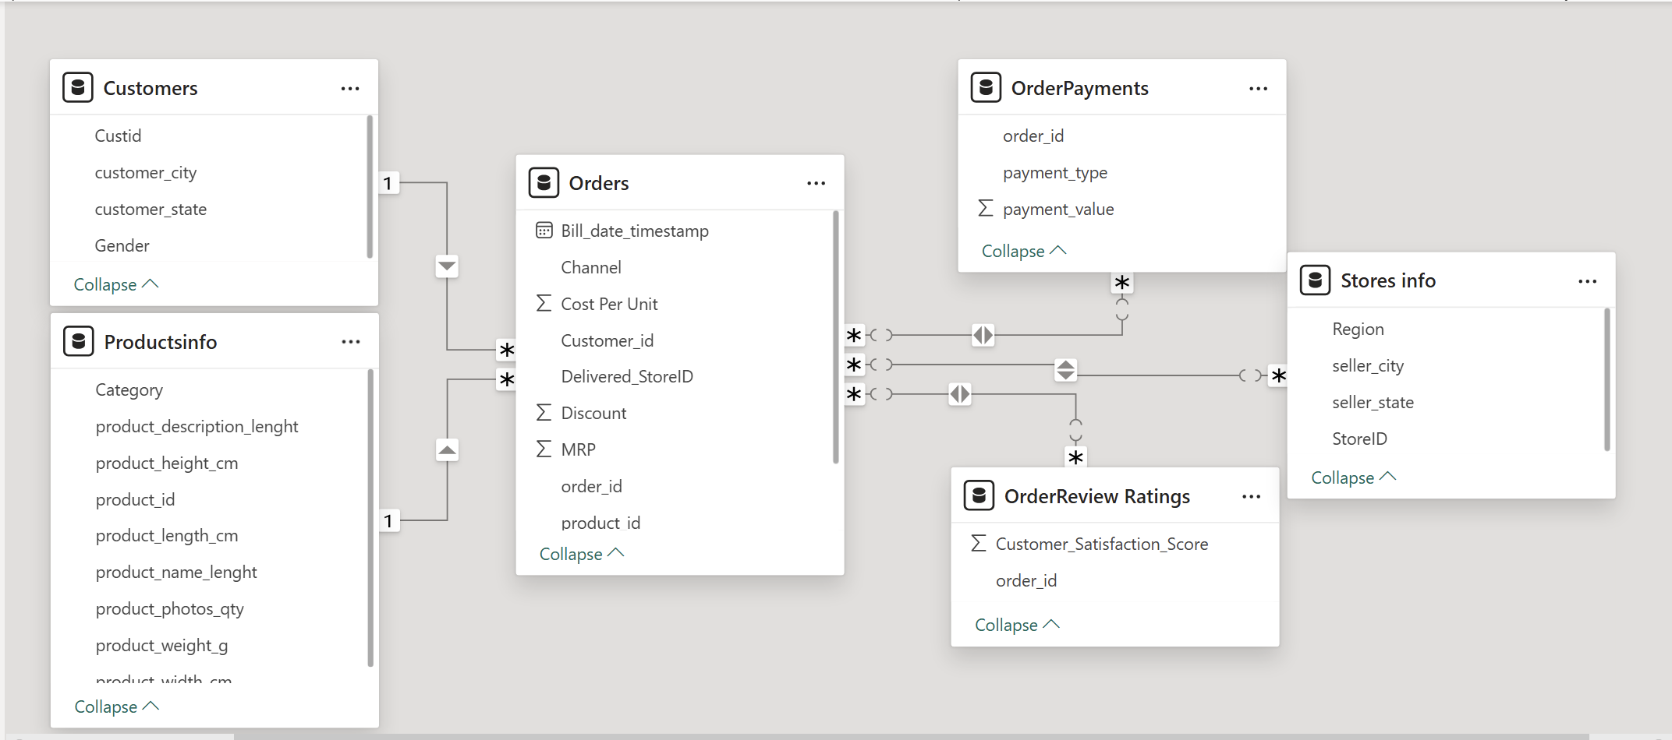
Table Relationships

Slide 6
Data checks and Data Consistencies
Customers
Table Inspection
No of records : 99441.
Columns : Cust_id, customer_city, customer_state, Gender.
Data quality checks
No duplicates in Cust_id.
No duplicate reocrds.
No null values.
Insights
Gender distribution :
Male : 29979.
Female : 69462.
Cities :
Total of 4119 cities.
City with most customers: Akkarampalle (15,540).

Slide 7
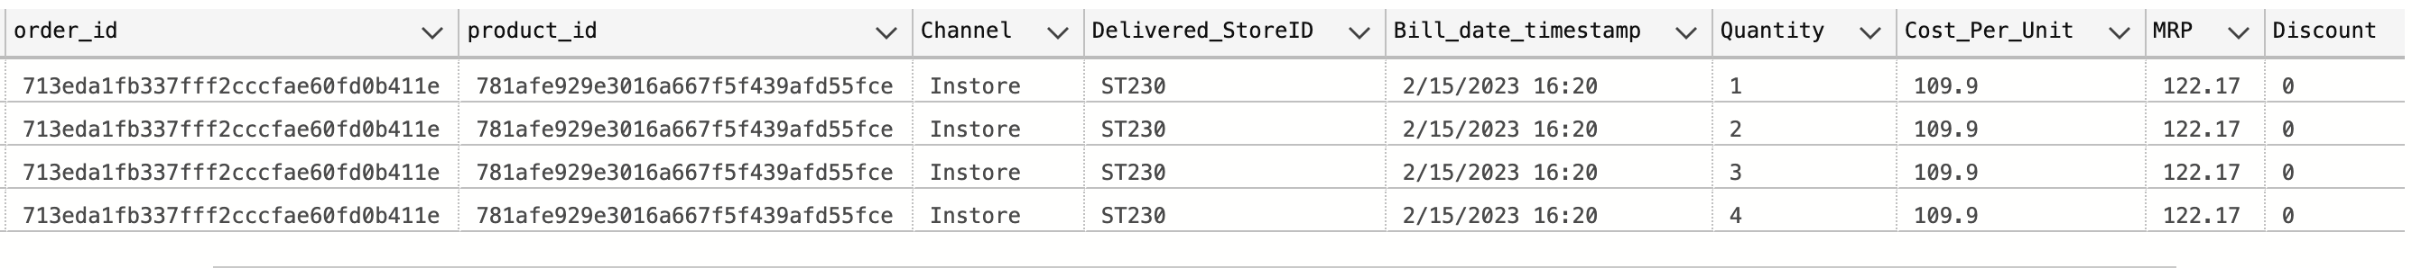
Orders (1/3)
Table inspection
No of records : 112650
No of unique order id : 98666
Columns : Customer_id,order_id,product_id,Channel,Delivered_StoreID,Bill_date_timestamp,Quantity, Cost Per Unit,MRP,
Discount,Total Amount.
Data quality checks
Cumulative count issue
for some orders, multiple records exist with identical customer, order, and product ID and the same time but varying quantities and total amounts. So duplicate entries are there.
This is a major issue .The Quantity values appear to be incremental, with the highest (last) Quantity value representing the final total ordered quantity.
Solution
Keep only the record with the maximum Quantity per Order_ID.

Slide 8
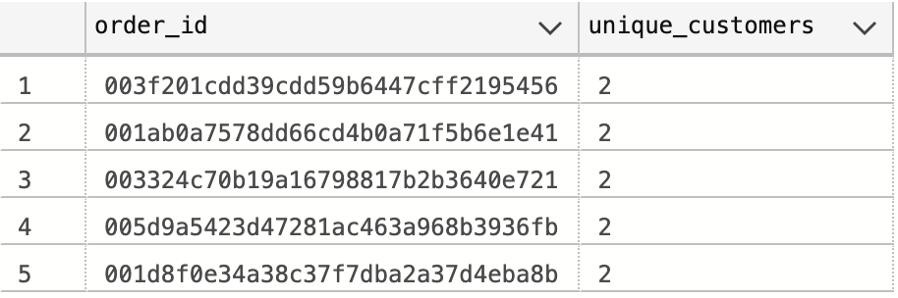
Orders (2/3)
Date format issue
While importing the dataset into SQL Server, the import process failed, because Bill_date_timestamp column
was in the datetime2 format.
Solution
To successfully complete the import, the column was temporarily converted to the nvarchar (text) data type during import. Once the data was loaded, the column was converted back to the appropriate datetime2.
Orderid count issue
Some orderids which are present in orderpayments table are not present in the orders tables.
Orderid integrity issue
Identified cases where the same order ID was linked to multiple customers.
Billing consistency verified:
Total Amount = Quantity × (MRP - Discount) holds consistently.
Order timeline:
Data includes orders from Feb 2020 through Oct 2023
Order date issue
There are orders which were placed before sep 2021.
There are 4 such records.

Slide 9
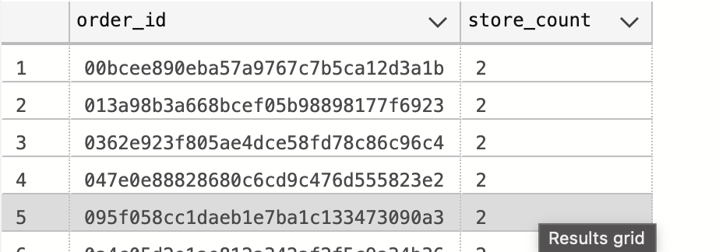
Orders (3/3)
Store id distribution issue
Multiple store ids for a single order id.
Case | Meaning | Discrepancy?
Each order must belong to one store | Data quality issue | Yes
System allows multi-store orders | Expected behaviour | No
Needs further clarification from the client
Bill date issue
Same order id having different bill dates
If each store updates the billing separately, their billing timestamps will differ — even though the backend mistakenly kept the same order id.
How this creates discrepancy -- If each store updates the billing separately, their billing timestamps will differ — even though the backend mistakenly kept the same order id.
Needs further clarification from the client.

Slide 10
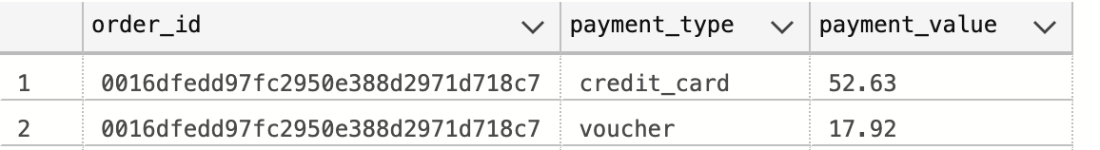
OrderPayment (1/2)
Table inspection
Total records: 103,886.
Unique order_id: 99,440.
Columns : order_id, payment_type, payment_value.
Duplicate records: 615 rows across 308 order_ids.
Some orders have multiple payment methods.
# Voucher + Credit Card: 2,245 orders
# Credit + Debit Card: exists for a single order
Data quality checks
No null or missing values.
9 entries with zero or negative payment_value.

Slide 11
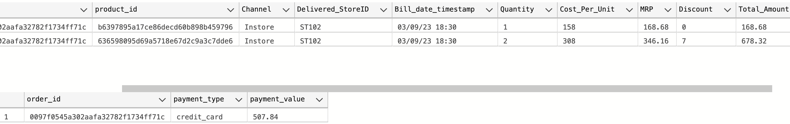
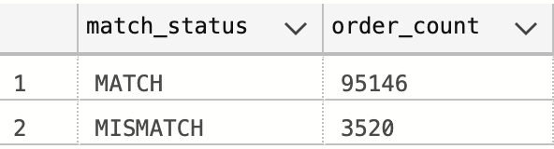
OrderPayment (2/2)
Total amount mismatch
There are records in order table whose Total Amount not matching with the payment value in Order Payments table.
No of such records is,

Slide 12
Order Review Ratings
Table inspection
Total records: 100,000
Columns : order_id, Customer_Satisfaction_Score
Duplicates: 555 order_ids, each appearing twice
Solution: Delete 1 duplicate row per order_id to keep unique records
Null values: None — all ratings present
Data quality checks
No null or missing values

Slide 13
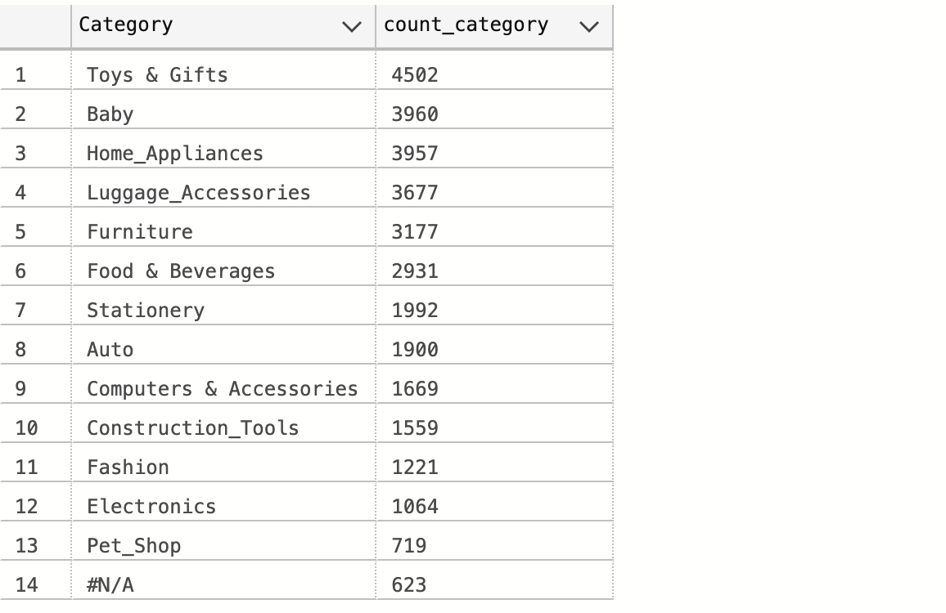
Productsinfo (1/2)
Table inspection
Total records: 32,951
Category, Product_id, product_description_length, product_height_cm, product_length_cm, product_name_length, product_photos_qty, product weight_g, product_width_cm
Duplicates: None — all product_ids are unique
13 valid categories
Data Distribution

Slide 14
Productsinfo (2/2)
Data quality checks
Spelling errors in column names
Affected columns ; product_name_length, product_description_length
623 products have Category = #N/A , Likely missing data during product upload new or unorganized products
Out of 623 [#N/A] products 610 have nulls in product_name_length, product_description_length, product_photos_qty
product_weight_g, product_height_cm, product_width_cm each have 2 null values
Some products have weight zero

Slide 15
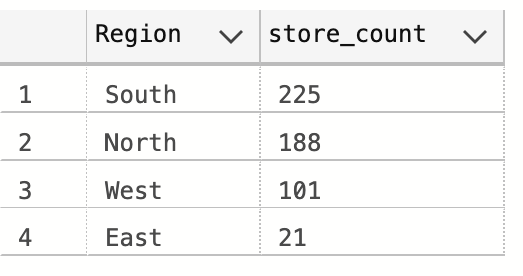
Stores info
Table inspection
Total records: 535
Columns : Region, seller_city, seller_state, StoreID
Geography ;
Total cities: 534
Total states: 19
Most stores: Andhra Pradesh → 126 stores
Least stores: Uttaranchal → 1 store
Data Distribution
Data quality checks
Duplicate store IDs: ST410 occurs 2 times, ST411 missing
Null values: None

Slide 16
Data cleaning activitys
Reviewed all tables for missing, duplicate, and inconsistent records.
Checked for data type mismatches (e.g., numeric fields stored as text).
Validated foreign key relationships between fact and dimension tables.
Verified that date/time formats were consistent across datasets.
Store Table Cleaning
Identified a duplicate record for StoreID: ST410 in the Stores Info table.
Verified both entries for consistency — data was identical.
Action : Dropped the duplicate record to maintain data integrity.
Product Info Table Cleaning
Identified 14 product categories in total.
One category was incorrectly labeled as “#N/A.”
Action : Renamed “#N/A” category to “Others” for clarity and consistency.

Slide 17
Order Review Ratings Table Cleaning
The table initially had 100,000 rows.
Detected 555 duplicate order_id entries with different ratings.
Action Taken: Combined duplicates by taking the average Customer Satisfaction Score for each order.
Final cleaned table contains 99,441 rows.
Order Payment Table Cleaning
Identified orders with split payments across multiple method
(e.g., part via Voucher, remaining via Credit Card, UPI/Cash, or Debit Card).
To consolidate payment data, transformed the table using a PIVOT operation.
Converted payment types from rows to columns and aggregated values by order_id.
Created a new table orderpayment pivot with separate columns for each payment method
and a calculated total payment amount per order.
Final cleaned table contains 99,440 total records.

Slide 18
Orders Table Cleaning
The table initially contained 112,650 records.
Duplicates occurred due to progressive cumulative transaction logs.
Action : Retained only the record with the highest quantity for each order–product pair.
Identified records with bill date outside the valid range (2021-09-01 to 2023-10-31).
Action : Removed 4 rows falling outside the specified billing period.
Found records with multiple store id values under channel = ‘In-Store’.
Action : replaced store with lower Total Amount by store with higher Total Amount.
Detected order id entries with multiple bill_date values.
Action : replaced the date with first occurance date
Detected 1 order which is present in orders but not in order payments.
Action : Deleted that record.
Detected single order id mapped to different customers.
Action : Replaced customer with lower Total Amount by customer with higher Total Amount
Final cleaned table retained 101,349 valid records.

Slide 19
Data Mismatch Summary — Orders vs Payments
Objective:
To validate data consistency between cleaned orders and order payment pivot tables at the order level.
Findings:
Total Orders Compared : 101,349
Matching Records : 95,204
Mismatched Records : 6,145
Nature of Mismatches:
Amount Variations — Differences between Total Amount (orders) and Total Amount (payments) for the same order id.
Impact:
May affect financial reporting accuracy and revenue reconciliation.
Requires validation against source transaction logs to ensure integrity of payment records.
Action
Identified 6145 mismatched records using Total amount comparison logic.
Created a new audit table cleaned orders mismatch to store all mismatched entries for reference and traceability.
Preserved all columns from cleaned orders into cleaned orders mismatch.
Deleted mismatched records from cleaned orders using the same validation condition to retain only consistent entries.
Finalized cleaned orders with Matching Records: 95,204 for further analysis.

Slide 20
Customer360
Constructed Customer360 view by integrating order transactions,
payments, store details, product categories, and customer satisfaction scores.
Captured key customer demographics including City, State, and Gender to enable geographic and gender-based segmentation.
Measured customer tenure using transaction dates to identify loyalty via the span between first and last purchase,
along with recent inactivity periods.
Purchase behavior:
Frequency of orders ( Number of distinct orders per customer).
Monetary contribution (Total revenue generated by each customer).
Profitability insights through total calculated profit per customer.
Analyzed shopping diversity by counting distinct products, categories, channels, stores, and cities associated
with each customer
Highlighted discount and loss transactions to pinpoint customer sensitivity to discounts and potential revenue erosion scenarios.
Explored payment behavior by classifying the number and type of payment transactions (Credit Card, Debit Card, Voucher, UPI/Cash) used by customers, including identifying the preferred payment method per customer based on transaction volume
Aggregated customer experience metrics through the average customer satisfaction rating, providing a quality
measure for service assessment.

Slide 21
Order360
Developed an Order360 dataset by consolidating order-level details, including customer, product, store,
and transaction time information.
Quantified order content by counting distinct items, total quantity, and product categories per order for inventory insights.
Calculated financial metrics such as total order amount, total discount, cost, and profit to monitor order-level profitability.
Flagged orders with loss-making status and those yielding high profit, enabling financial risk assessment.
Identified orders occurring on weekends and classified orders into time segments (morning, afternoon, evening)
to understand purchase timing trends.
Included channel and store identifiers along with seller location to link order performance with sales points.
Averaged customer satisfaction scores at the order level to assess immediate post-purchase experience.

Slide 22
Store360
Created a comprehensive Store360 dataset by aggregating order data at the store level,
incorporating sales, product, location, payment, and customer satisfaction details.
Captured store demographics including City and State to enable geographic performance analysis.
Summarized order content and sales metrics, including the number of distinct products, total quantity sold, total sales,
total discount given, and total cost and profit generated by each store.
Flagged loss-making stores by aggregating orders with negative profit and identified stores with a significant number
of high-profit orders for targeted business strategies.
Analyzed transaction timing by counting sales on weekends versus weekdays and during different time-of-day slots
(morning, afternoon, evening, night) to optimize store operations and marketing campaigns.
Calculated performance ratios such as average order value, average profit per transaction, average profit per customer,
to benchmark store efficiency.
Measured customer experience via average customer satisfaction ratings aggregated at the store level.

Slide 23
Detailed EDA
Some aggregated values
Aggregated metrics | Values
Total orders | 95204
Total customers | 95115
Total products | 30893
Total stores | 37
Total revenue | 15031051.84
AOV | 157.88
Revenue per customer | 158.03
Profit margin % | 14

Slide 24
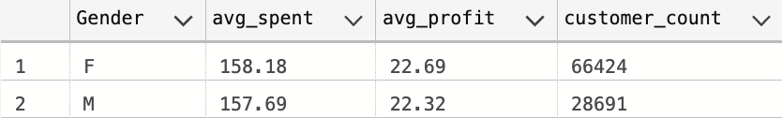
Customer 360 EDA (1/4)
Customer count per state :
60 % of the customers are from Andhra Pradesh
Average spend per state :
# Highest average money spent = West Bengal (190.31)
# Highest total revenue = AP
# Highest avg profit = 30.7
Gender wise spending :
# 69.84 percentage of the total customers are female
# avg spent (F) = 158.18
# avg spent (M) = 157.69
Average profit and discount per transaction

Slide 25
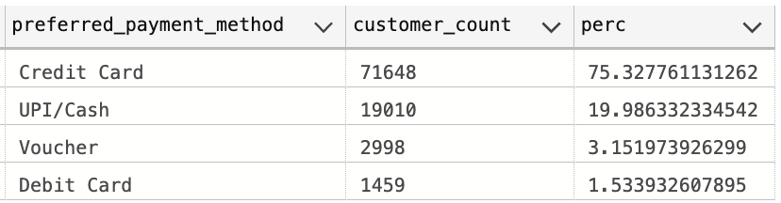
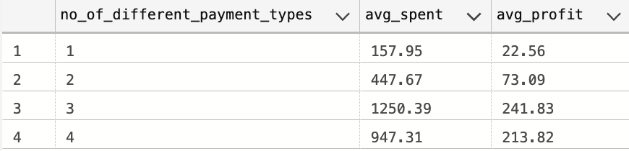
Customer 360 EDA (2/4)
Distribution of preferred payment method
Payment diversity vs spending

Slide 26

Customer 360 EDA (3/4)
Average tenure, inactivity, and frequency
# Since most of the customers are one time buyers avg tenure days is zero.
Weekday vs Weekend transactions
# Total transactions on weekday = 75157
# Total transactions on weekend = 19938
Hourly activity patterns
# Most transactions were done on Afternoon = 30729
# Less transactions were done on Morning = 17966
Customer segmentation (frequency segment)
# one time buyers = 95080
# moderate buyers = 29
# frequent buyers = 6
One time buyer
Moderate buyer (no of trns between 2 and 7)
Frequent buyer (no of greater than 7)

Slide 27
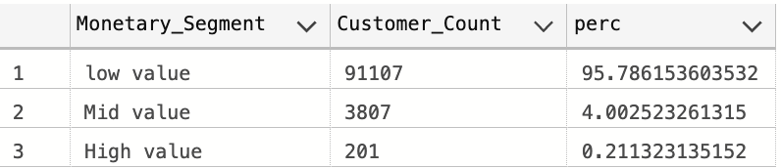
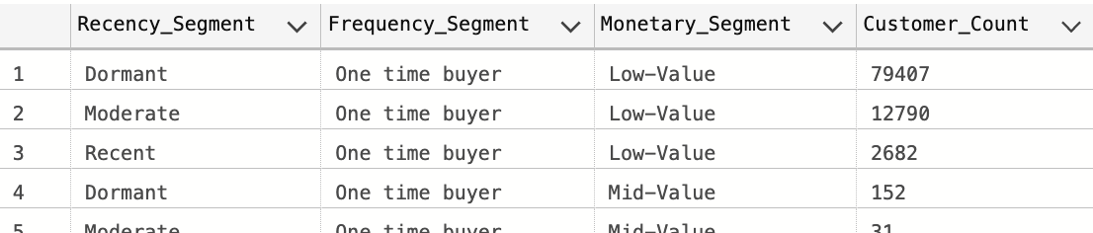
Customer 360 EDA (4/4)
Customer Segmentation monetary segment
# 95.7 % of customers are low value.
# High value customers are very less.
HIGH ( Tot amount spent > 2000 )
MID ( 500 < Tot amount spent < 2000 )
LOW ( Tot amount spent <500 )
Combined RFM summary
# Majority of the customers are dormant , onetime buyers of low value.
Inactive days < 30 = Recent
Inactive days < 90 = Moderate
Inactive days > 90 = Dormant

Slide 28
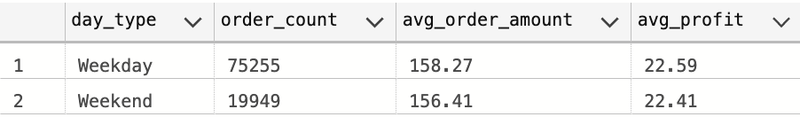
Order 360 EDA (1/3)
Basic Summary Metrics
# Total orders - 95,204
# Total customers - 95,115
# Total quantity sold - 1,04,658
# Total revenue - 15.03 million
# Total profit - 2.15 million
Average values per order
# Avg quantity per order - 1
# Avg item per order - 1
# Avg order amount - 157.88
# Avg order profit - 22.55
Percentage of loss-making orders
# 0.36 % of orders are loss making
# That means 338 orders out of 95204 orders.
Weekend vs Weekday orders

Slide 29
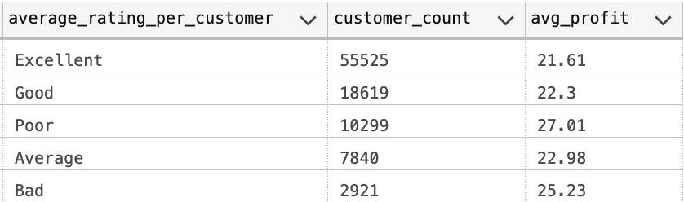
Order 360 EDA (2/3)
Order patterns by time of day
# Most orders were placed at afternoon which 30,752 orders, with an average order value of 163.33 rs.
# At evening and night almost 23,000 orders were placed . At evening with an average order value of 162.41 and at evening 141.27.
Orders by channel
# 87.9% of orders were placed through channel Instore, with average order value of 157.27.
# Only about 1.6% of orders were placed through channel Online, with an average order value of 181.25.
Orders by payment type
# 75% of orders used credit card for the payment.
# 19% used UPI/Cash.
# 1% used debit card.
Average rating and profit relationship

Slide 30
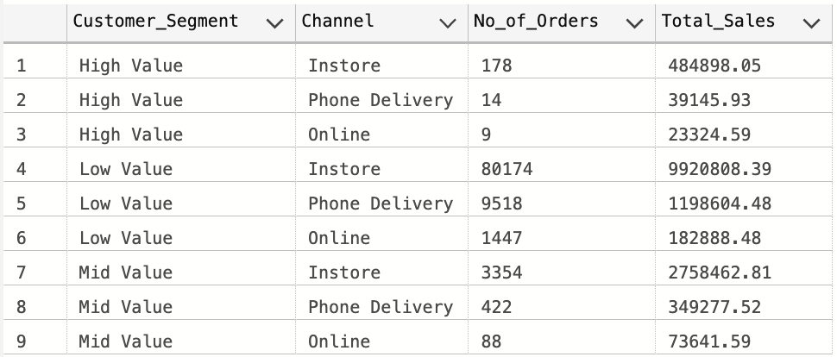
Order360 EDA (3/3)
Channel Usage by Customer Type
Discount Usage by Customer Type
# 40% orders are discounted orders.
# 91% of the total discounted amount was availed by low value customers.

Slide 31
Order360 EDA (3/3)
MoM growth
# Most revenue was generated on august 2023.(1.19 million)
# Most months show positive month-on-month growth, and the increases are much higher than the decreases.
# Even though there are a few dips, the overall trend points towards strong and consistent revenue growth over time.
Category wise revenue
# Highest revenue is generated from the category “Toys & Gifts”
# Followed by “Home appliances”, “Food and Beverages”, “Luggage accessories” and “Baby”
# Least revenue is generated from category “Pet shop”, “Fashion” and “Others” (which are NA in the table so have no information about
what category those products are from)

Slide 32
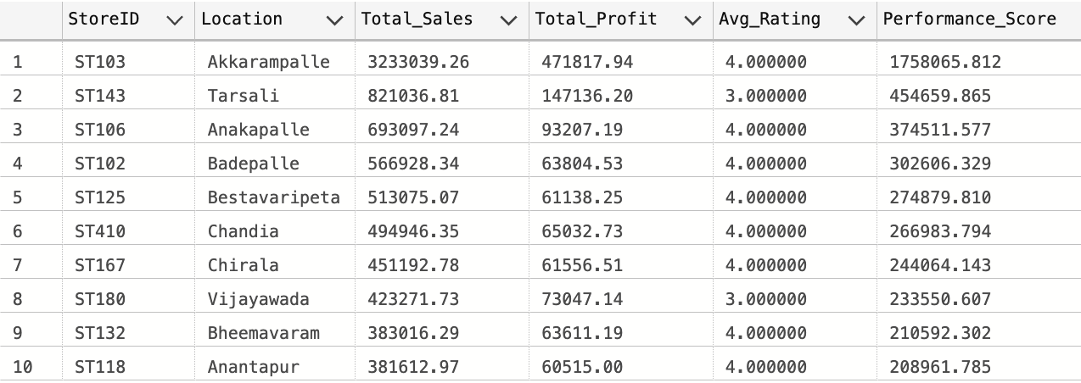
Store 360 EDA (1/1)
High-Profit Stores
# Instore is the highest performing channel , and highest revenue generating store is “ST103”.
# Out of 37 stores 22% of the revenue is coming from store “ST103”. Which is at “akkarampalle” in Andhra Pradesh.
Top 10 Stores by performance score
Performance score
SUM(Amount)*0.5 + SUM(Total profit)*0.3 + AVG(Average rating)*0.2

Slide 33
Detailed List of Exploratory Data Analysis (Descriptive & Diagnostic)
Customer360
Descriptive Analysis (What happened?)
KPI’s / Metrics
Total number of customers
Average profit per customer
Average customer rating
% of discounted orders
Average customer spent value
Preferred payment method
KRA’s (accountability)
Increase ARPU (average revenue per user)
Raise repeat purchase rate
Reduce no of transactions with loss

Slide 34
KRI’s (risks to monitor)
Rising proportion of transactions with loss
Decrease in average customer rating below threshold
Increased discount dependency (total discount / total amount spent)
Descriptive analyses (what to show and how)
Distribution plots : total amount spent, no of transactions, total profit
Bar / map : spend & profit by city/state
Payment method pie /stacked bar : preferred payment method by city/gender
Boxplots : total amount spent by gender / rating category
RFM table & segments : Top customers, at-risk customers
Diagnostic analyses (why things happened)
Correlation : Total amount spent vs no of distinct categories purchased vs no of channel used
Segmentation : CLTV segments and their average discount usage / return rate
Cohort analysis : retention curves by channel / city
Causal checks : did voucher campaigns increase spend but reduce profit margin? (compare matched cohorts)
Customers with high voucher use & low profit → flag for costly acquisition
Customers with many transactions with loss → investigate returns/refunds

Slide 35
Store360
KPIs
Total revenue through channel instore
Best performing store
Average Order Value (AOV) = Average order value
Average profit per store
City wise store revenue
Average rating per store
KRAs
Increase store-level gross margin
Improve Average rating per customer
Reduce stockouts / increase distinct categories coverage
KRIs
High Discount / Low Profit ratio
Sudden drop in Weekend sales or Average customer visits
High variance in Average profit per transaction

Slide 36
Descriptive analyses
Store ranking : revenue, profit, AOV
Heatmap / map : store profit by location
Time-series : store-level weekly sales & profit (weekend vs weekday)
Distribution plot : Distinct categories across stores (to spot narrow assortments)
Diagnostic analyses
Root-cause for Flag loss making: high discount, low traffic, poor category mix, high returns
Basket analysis: which categories increase AOV / profit?
Promotion lift: compare store sales before/during/after promotions using difference-in-differences
Inventory & SKU-level check: No of items vs Qty sold → identify dead stock

Slide 37
Orders360
KPIs
AOV
Order Profit Margin
Total orders
Average quantity per order
KRAs
Reduce %loss-making orders
Increase share of high-profit orders
Improve order rating (avg rating)
KRIs
Increased rate of items with discount correlated with negative profit margins
Spike in loss-making orders during specific hours (hours flag)
Descriptive analyses
Time-of-day / day-of-week heatmap: volume and profit by hours flag & weekend trans flag
Channel performance: orders, AOV, margin by Channel & payment type
Order-level scatter: qty vs total profit to identify anomalies

Slide 38
Diagnostic analyses
Why orders loss-making : high discount, high returns, wrong pricing, cost miscalculation
High-profit order drivers : distinct categories, payment type, channel, store_ d
Anomaly detection : outlier orders with negative profit or abnormally high discount — root cause investigation

Slide 39
Descriptive Analysis Summary
KPI / Metric | Calculation | Variables | Visualization | Insight
Total Customers | COUNT(DISTINCT Custid) | Custid | KPI Card | 95,115 total customers identified.
Total Sales (Revenue) | SUM(Total_Amount) | Total_Amount | KPI Card | Total revenue generated is ₹15.03 million.
Average Order Value (AOV) | Total Amount / Total Orders | Total Amount, order id | Bar Chart | Average order value is ₹157.88.
Total Profit | SUM(total profit) | total profit | KPI Card | ₹2.15 million total profit recorded.
Gender-wise Spending | AVG(Total Amount) BY Gender | Gender, Total Amount | Bar Chart | Females (69.84%) spend slightly more (₹158.18) than males (₹157.69).
State-wise Spending | AVG(Total_Amount) BY State | Customer state, Total Amount | Map / Bar Chart | Highest average spend: West Bengal (₹190.31); highest total revenue: Andhra Pradesh.

Slide 40
Descriptive Analysis Summary
KPI / Metric | Calculation | Variables | Visualization | Insight
Payment Method Usage | COUNT(preferred payment method) BY Category | Preferred payment Type | Pie Chart | Credit Card: 75%, UPI/Cash: 19%, Debit Card: 1%.
Order Volume by Channel | COUNT(order id) BY Channel | Channel, order id | Bar Chart | 87.9% of orders placed In-store; only 1.6% online.
Customer Segmentation (RFM) | Frequency, Monetary, Recency | Inactive days, no of transactions, total amount spent | Table | Majority are one-time, low-value, dormant customers.
MoM Growth | % change in monthly revenue | order date, total revenue | Line Chart | Mostly positive growth with strong performance in Aug 2023.
Top Categories by Revenue | SUM(Amount) BY Category | Category, Total Amount | Bar Chart | Top: Toys & Gifts, Home Appliances, Food & Beverages.
Top Performing Store | SUM(Amount)*0.5 + SUM(Profit)*0.3 + AVG(Rating)*0.2 | Store ID, Amount, Profit, Rating | KPI Card | Store ST103 (Akkarampalle) generates 22% of total revenue

Slide 41
Diagnostic Analysis Summary
Diagnostic Focus | Method / Analysis | Variables | Observation / Insight
High Revenue from Toys & Gifts | Category-level comparison | Category, Total Amount | Toys & Gifts show the highest sales volume and AOV; likely due to seasonal or gifting trends.
Low-Value Customers Availing Most Discounts | Segmentation by Discount vs Spend | Discount, total amount spent, items with discount | 91% of total discounts used by low-value customers — indicates over-discounting to low spenders.
Loss-Making Orders (0.36%) | Flag & Profit Ratio | Flag loss making | Only 338 orders are loss-making, due to cost per unit same as mrp.
Gender Spending Difference | Comparative Mean Analysis | Gender, Total amount spent , total profit | Female customers spend slightly more overall — may be due to category preferences.
Weekend vs Weekday Sales | Temporal Analysis | Weekend_Flag, Amount | 75,157 weekday vs 19,938 weekend transactions; weekday dominance suggests marketing gap on weekends.

Slide 42
Diagnostic Analysis Summary
Diagnostic Focus | Method / Analysis | Variables | Observation / Insight
Time-of-Day Patterns | Hourly Activity Trend | Hours_Flag, Amount | Afternoon shows the highest transaction volume (30,729 orders).
Channel Profitability | Channel-wise Margin Comparison | Channel, Profit | Online orders have higher AOV (₹181.25) vs In-store (₹157.27).
Store Dependency Risk | Store-level Revenue Distribution | Store_ID, Amount | Store ST103 generates 22% of revenue — high dependency risk if performance drops.
Category-Level Revenue Variation | Revenue Comparison by Category | Category, Amount | Pet Shop, Fashion, and Others categories underperform significantly — potential optimization areas.
Customer Churn Indicators | Tenure and Inactivity Analysis | Inactive_Days, Frequency | 95% customers are one-time buyers — very high churn risk.
Profit vs Rating Relationship | Correlation Analysis | Profit, Customer_Satisfaction | Weak positive relationship — satisfied customers tend to contribute slightly higher profits.

Slide 43
Customer360 dashboard layout
Objective
Understand who our customers are, how they interact with us, and what actions can improve satisfaction and loyalty.
Logo
Customer 360 Analysis
KPI’s = AOV, Order profit margin, Total customers, Average rating, Average spent per customer
Slicers
Date range
Region
Store ID
Channel
Payment Type
Customer Segment
Category

Slide 44
Order360 dashboard layout
Objective
Ensure every order is processed smoothly, identify issues early, and enhance customer satisfaction through timely delivery and accuracy.
Logo
Order 360 Analysis
KPI’s = AOV, order profit margin, Total orders, Average quantity per order, discount vs orders
Slicers
Date range
Region
Store ID
Channel
Payment Type
Customer Segment
Category

Slide 45
Store360 dashboard layout
Objective
See how each store is performing, what’s selling well, and where improvements are needed.
Logo
Store 360 Analysis
KPI’s = AOV, Store gross profit, Best performing stores , Average profit per store, Best selling category
Slicers
Date range
Region
Store ID
Channel
Payment Type
Customer Segment
Category

Slide 46
Tools Overview
Phase | Tool Used | Purpose / Activity
Data Viewing & Understanding | Microsoft Excel | - Initial data exploration and familiarization- Viewing datasets, verifying column structures, identifying nulls and outliers
Data Cleaning & Transformation | SQL (Microsoft SQL Server ) | - Removing duplicates and invalid entries- Validating data consistency (foreign keys, date ranges, mismatched records)- Creating cleaned and enriched tables (Customer_360, Order_360, Store_360)
Visualization & Dashboard Planning | Power BI (Planned) | - Dashboard creation for Customer360, Order360, Store360, products info, Customer satisfaction. views- KPI visualization, interactivity, and data storytelling
Presentation & Documentation | Microsoft PowerPoint | - Structuring findings, methods, and dashboard layout designs- Presenting final deliverables and insights clearly
Optional Support Tool | Excel + SQL Integration | - Cross-validation of record counts and sample data checks

Slide 47
THANK YOU!

